Slide 1
Introduction to Matlab
Week 7
Day 27

Slide 2
Recap: Matlab Basics
Matlab Window
Command window: type interactive mode commands, echoes results of interactive commands and actions from script file
Current Folder window: shows currently active folder contents
Workspace window: shows currently defined variables and their values
Command history window: shows previous commands entered in Command window – can copy from here & paste into editor or command windows

Slide 3
Recap: Matlab Basics
Matlab Math Operations
Uses same algebraic operators as VBA & Excel: + - * / ^
Many built-in math functions:
Syntax: FunctionName(Arguments), same as VBA & Excel
See list of functions: type “help matlab\elfun” in Command window
Variable & Script file names
Must start with a letter
Can only use letters, numbers, and underscore ( _ )
NO SPACES

Slide 4
Simple Input and Output
INPUT
a=input(‘enter value of A’);
OUTPUT
disp(a)
Construct a string variable to make disp more useful
message=['the value of pi is ' num2str(pi)];
disp(message)
Formatted printing
fprintf(‘print the value of a is % i \n’, a)
Format codes:
% i ( for integers)
%e (for exponential)
%f (for floating point format)

Slide 5
Solving simple problems with Matlab In-Class Exercise #1
Solve this problem using a script file:
Calculate
Where
a = 15.62,
b = -7.08,
c = 62.5,
d = 0.5 (a b - c)
Use built-in functions: abs(), sqrt()

Slide 6
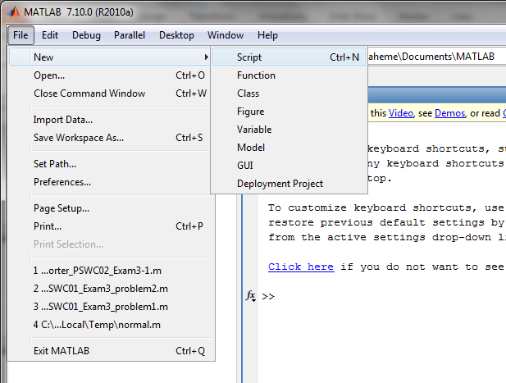
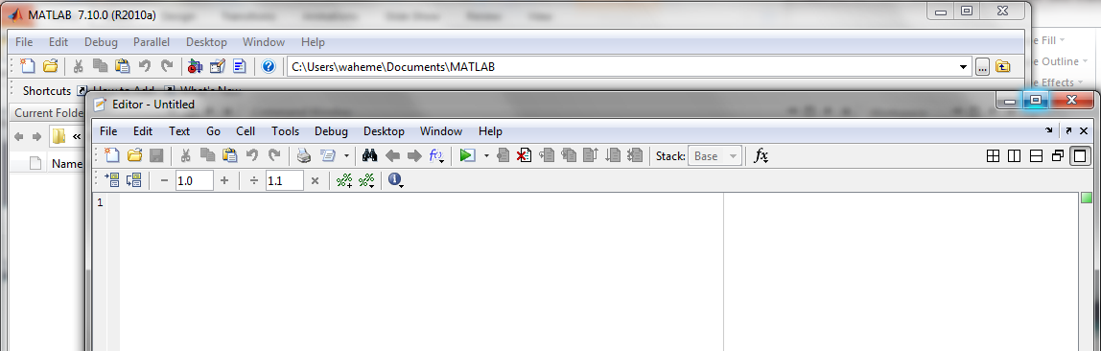
Using the Script Editor
File → New → Script
Script Editor Window

Slide 7
Solving simple problems with Matlab In-Class Exercise #2
Solve this problem using a script file:
Calculate
Where
x = 9.6,
z = 8.1
Use built-in function: exp()

Slide 8
In-Class Exercise #3: Volume and surface area of sphere
Take user input for radius and calculate the volume and surface area of a sphere
Vol = 4/3 * pi * r^3
S_area = 4 * pi * r^2

